Slide 1
PROBLEM STATEMENT
The problem is all about categorising the bank customers into different categories having strong similarity within the group .with the dataset containing bank transactions data. Some of the data elements are transaction id, customer id ,transaction amount , mode of transactions, etc.Need to come up with algorithms that can segment users into different categories.So the problem is of unsupervised learning in nature.

Slide 2
Hypothesis Generation
Generally for a bank there will be customers of different categories differ by different aspects like working professionals, students, salaried employees from private and govt organisations, business people , entrepreneurs, investors ,pensioners etc.so their transactions with bank varies some may use saving accounts like all employed people, some may open current accounts like entrepreneurs,business people. Another type like investors use accounts for their fixed deposits or in bonds .As a result transactions with bank also varies from type of category that the person is into.so these are some of the aspects that we can classify the customer into different categories like transactions , profession they are into.so by identifying these similar characteristics we can classify into different groups or categories.

Slide 3
Exploratory Data Analysis
Given data containing different attributes of observations containing 2653 observations
Total seventeen variables with 2653 observations
Out of those six are continuous variables and remaining are categorical in nature
Now we will see the distribution of each and every variable also , doing bivariate analysis

Slide 4
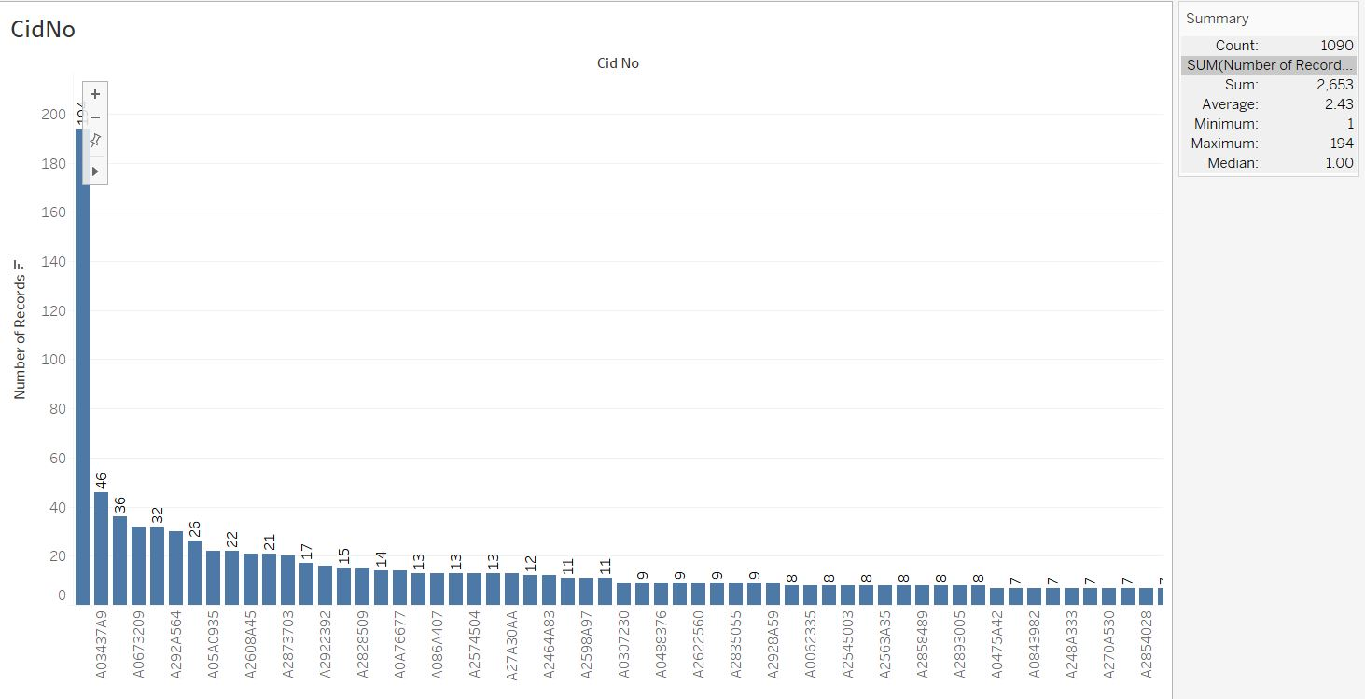

Slide 5
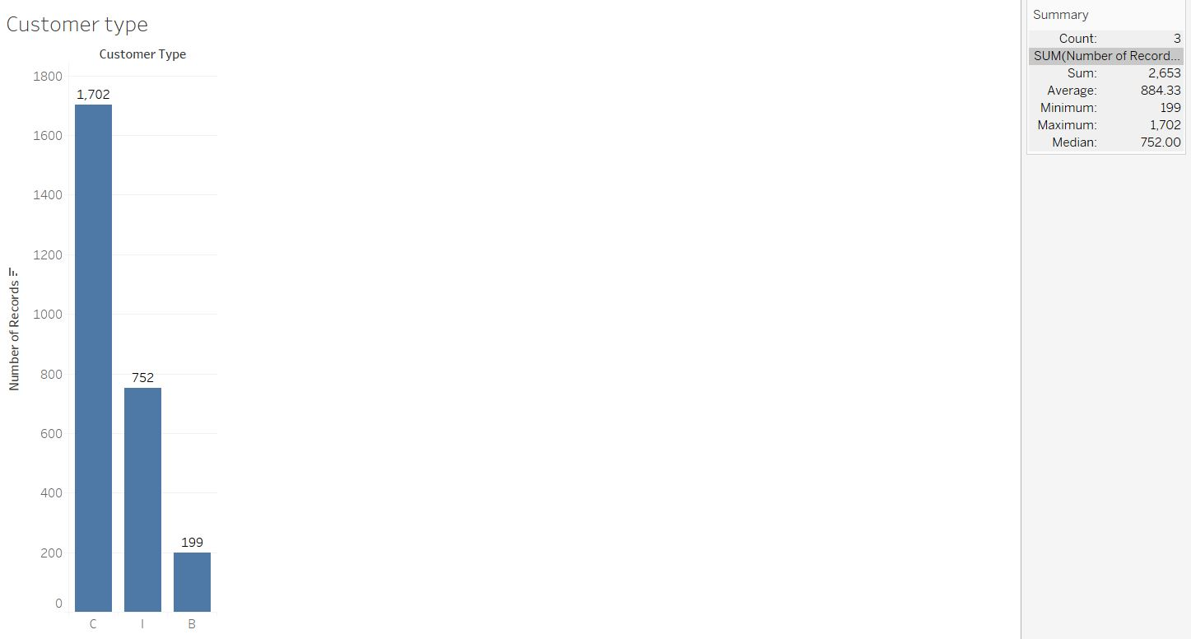

Slide 6
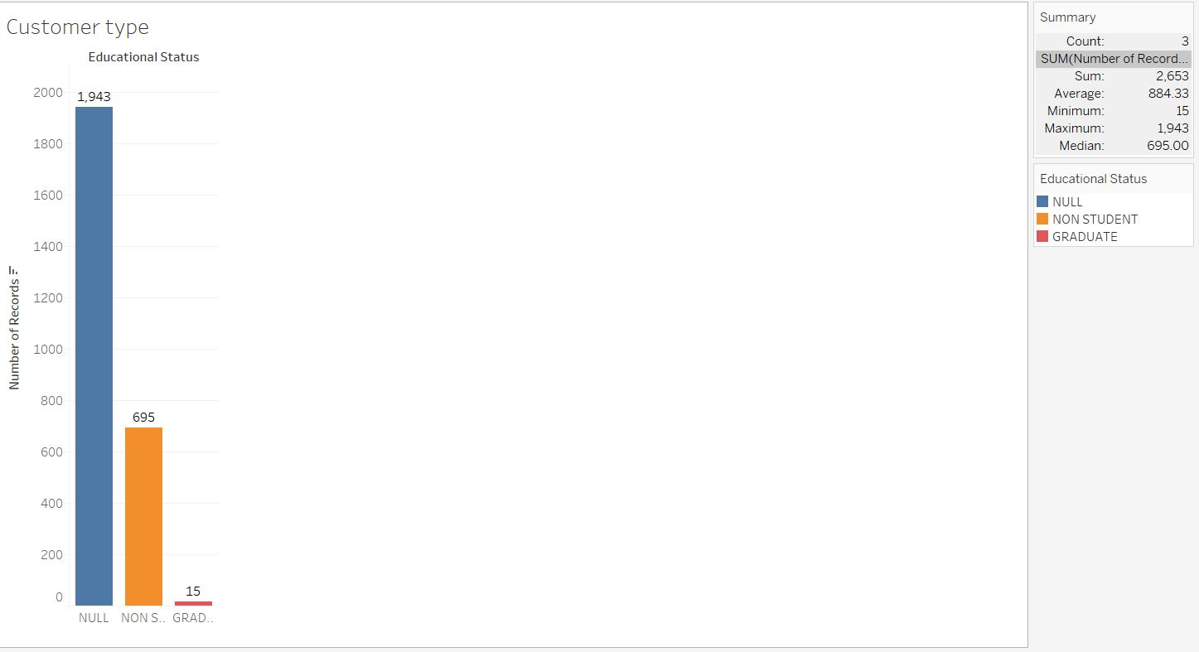

Slide 7
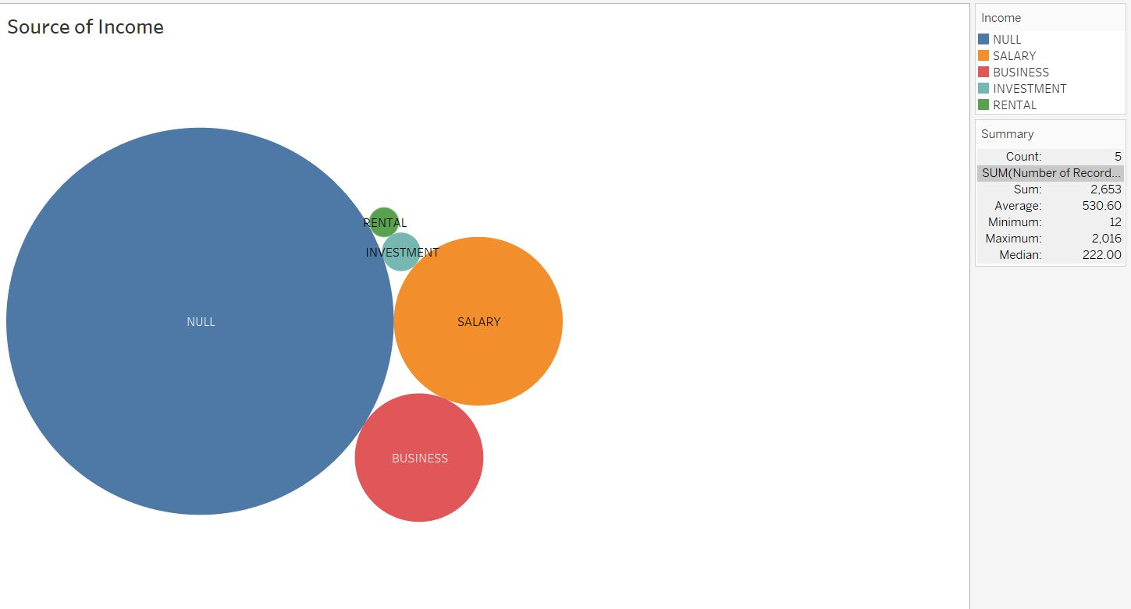

Slide 8
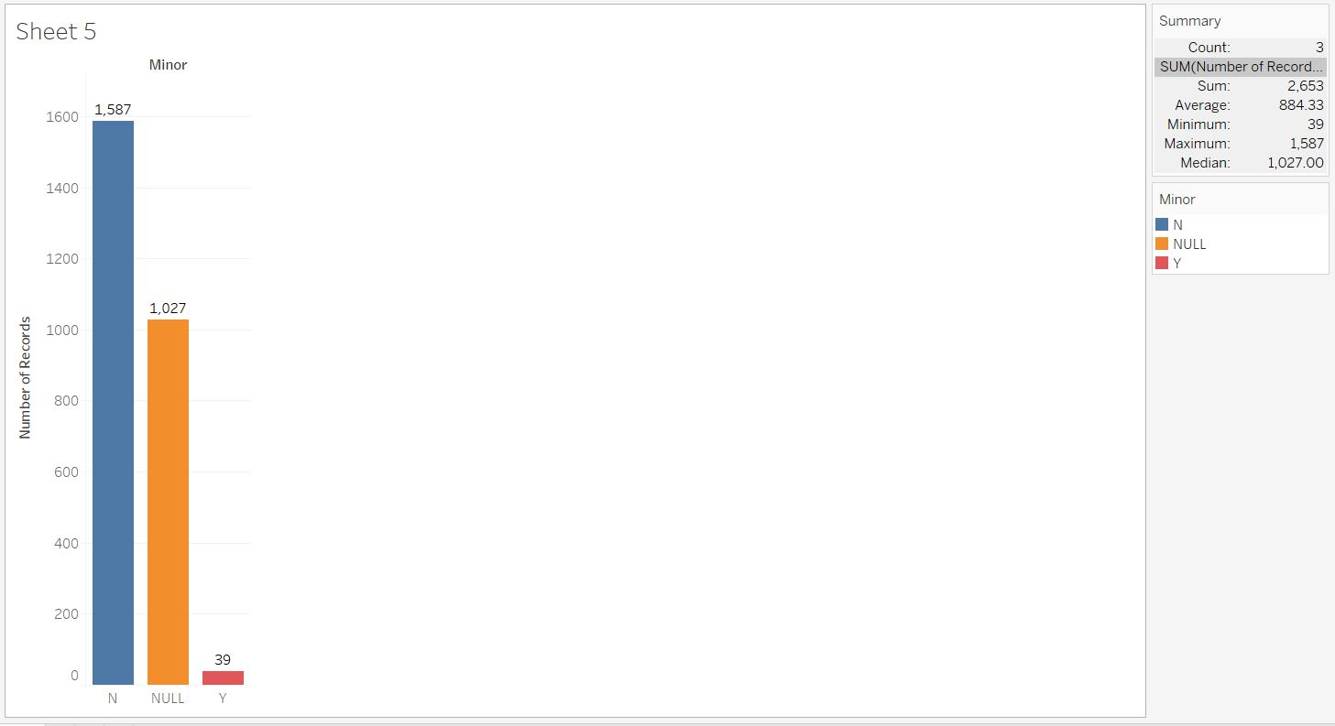

Slide 9
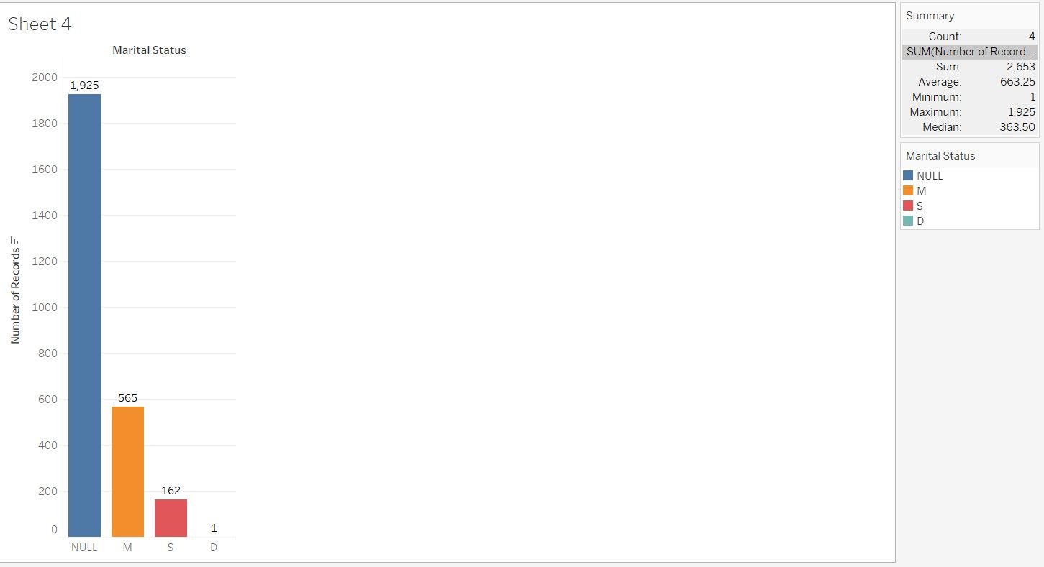

Slide 10
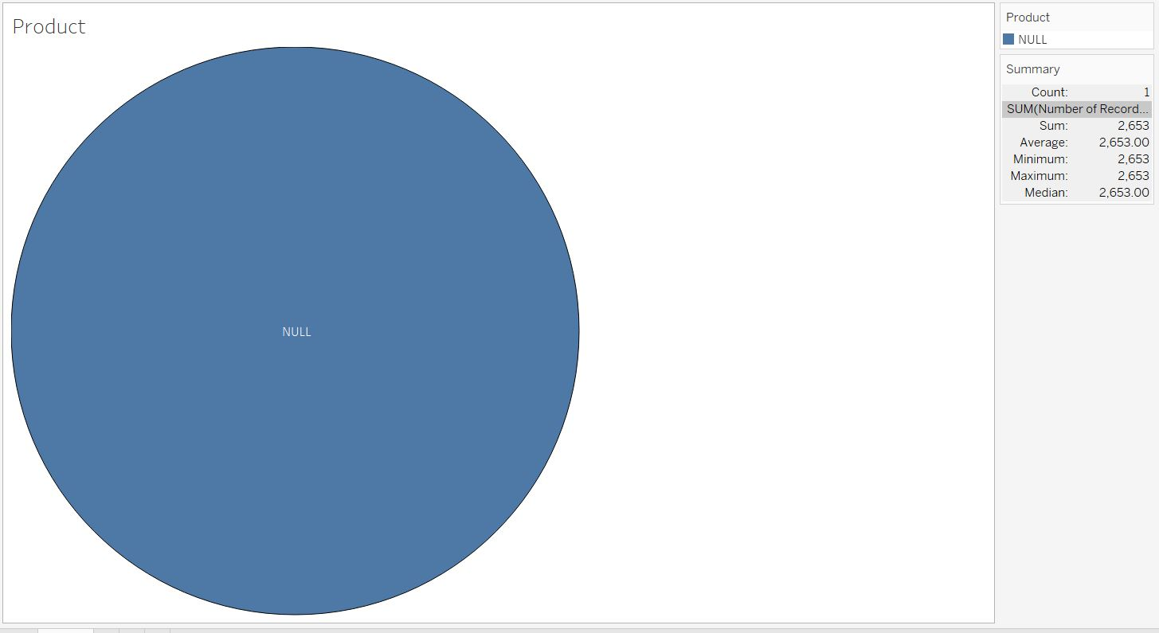

Slide 11
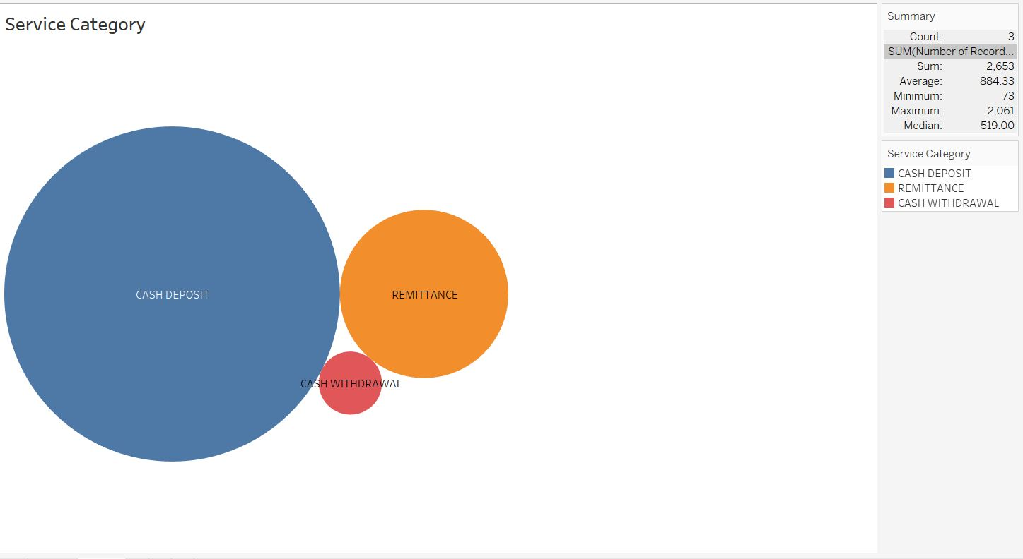

Slide 12
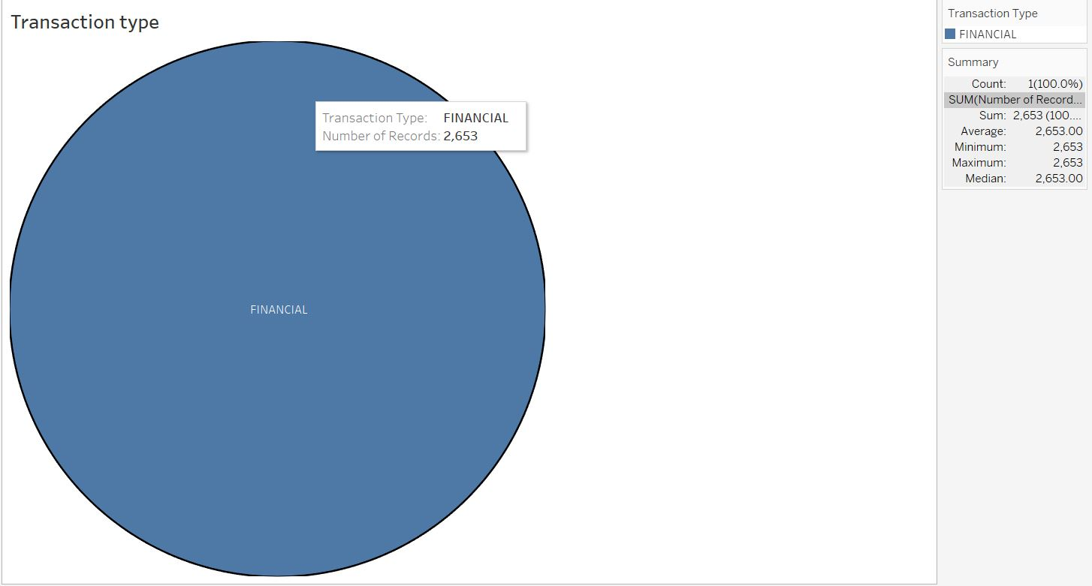

Slide 13
Bivariate /Trivariate Analysis with interesting findings

Slide 14
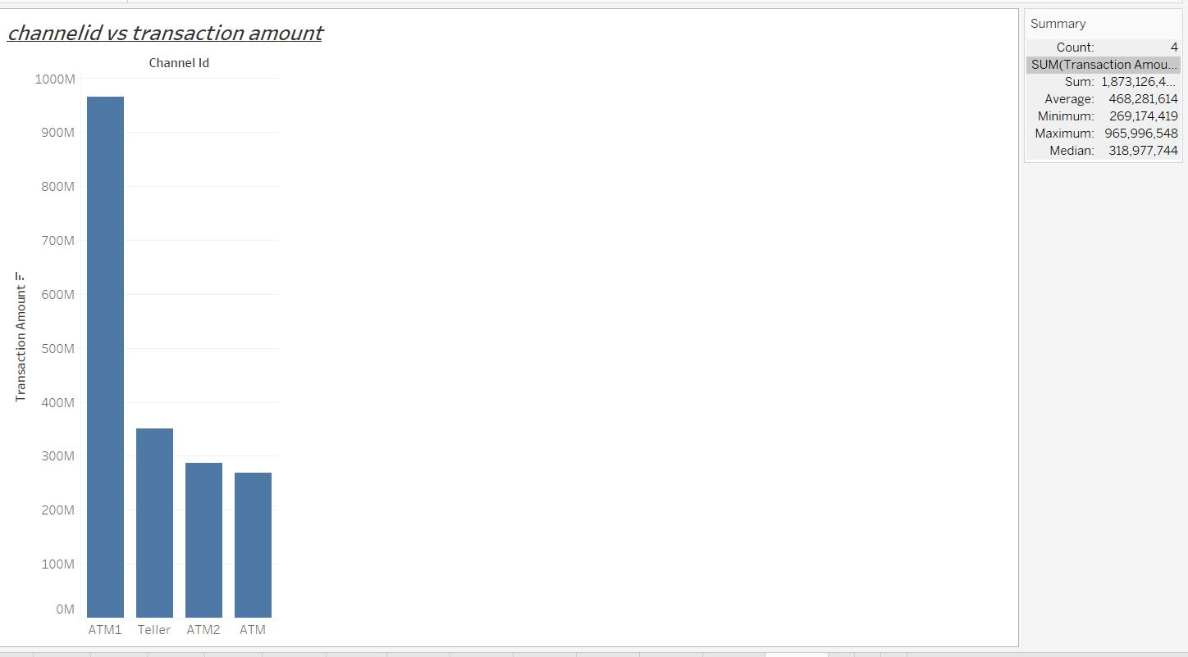

Slide 15
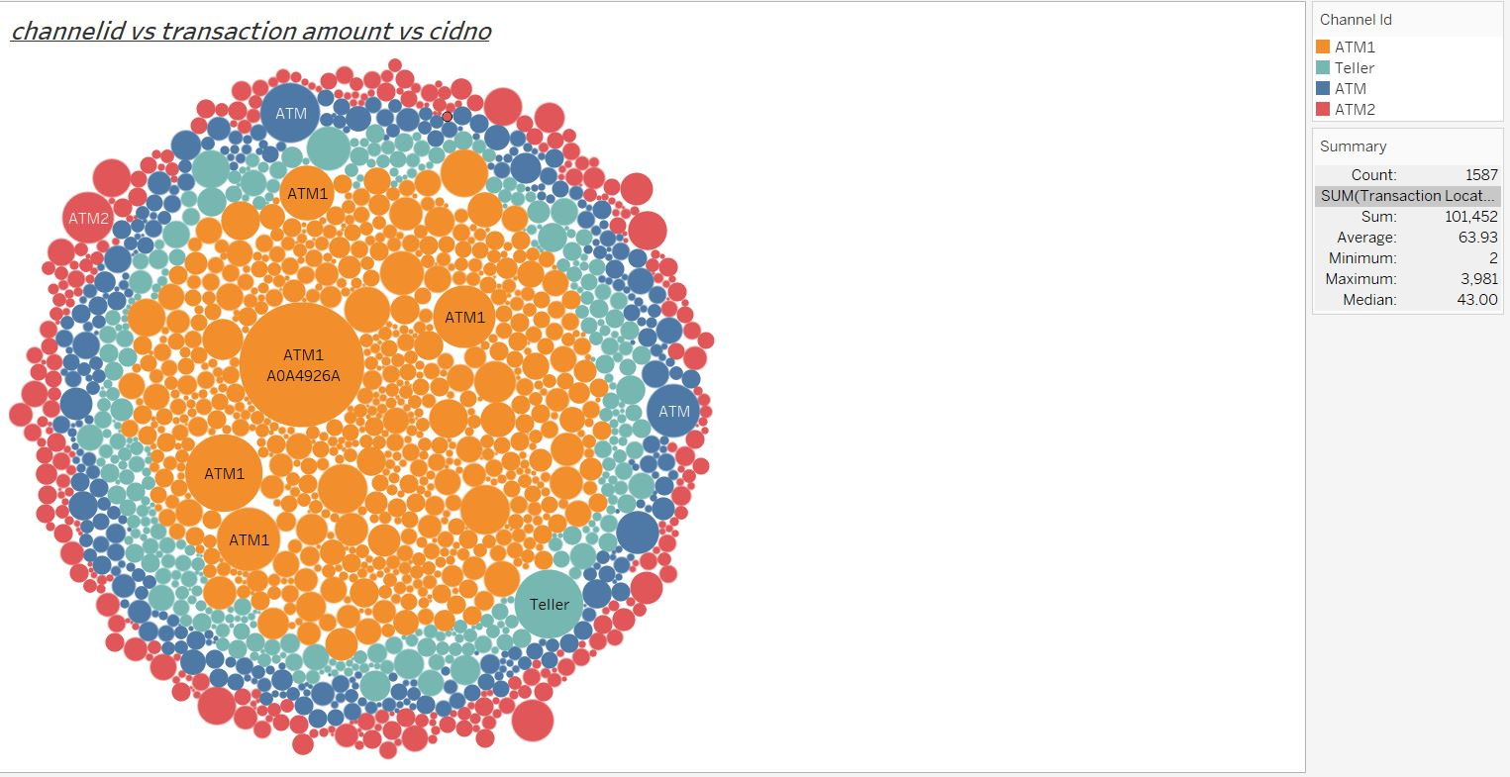

Slide 16
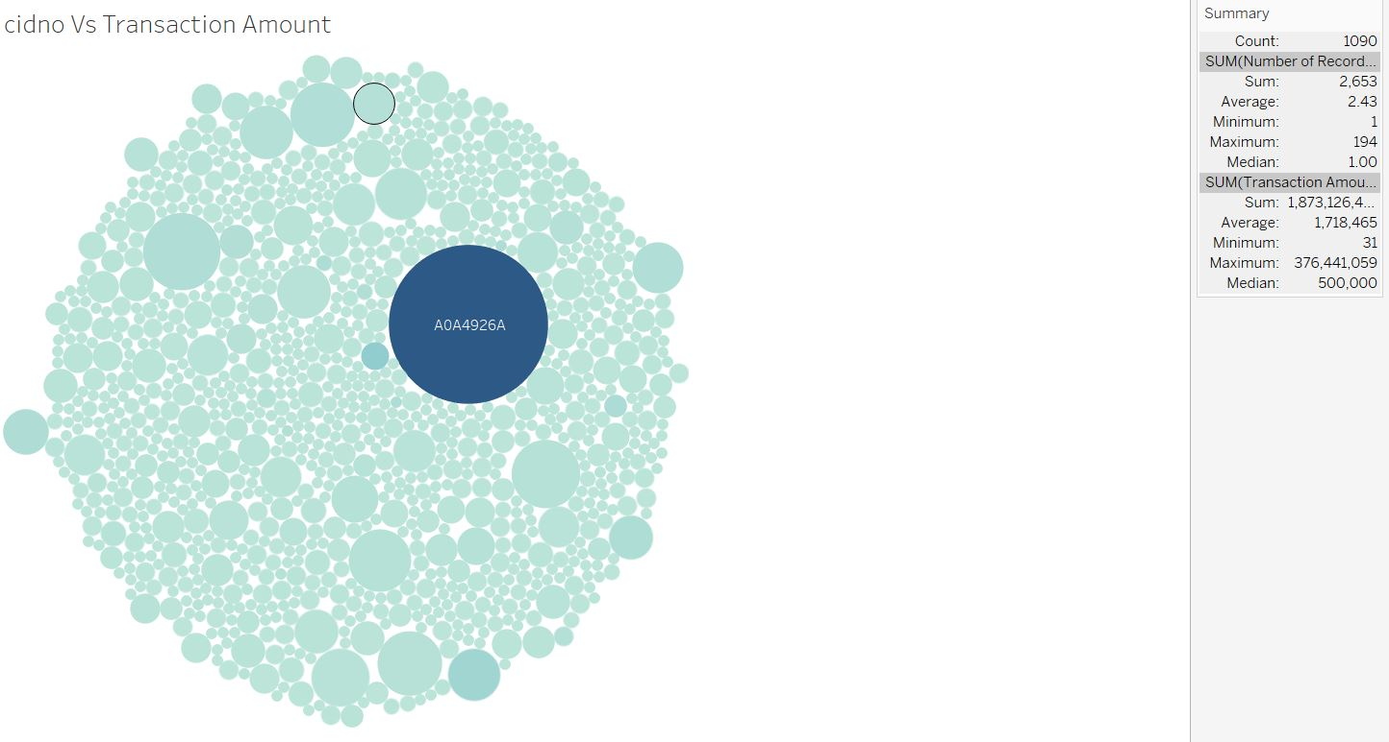

Slide 17
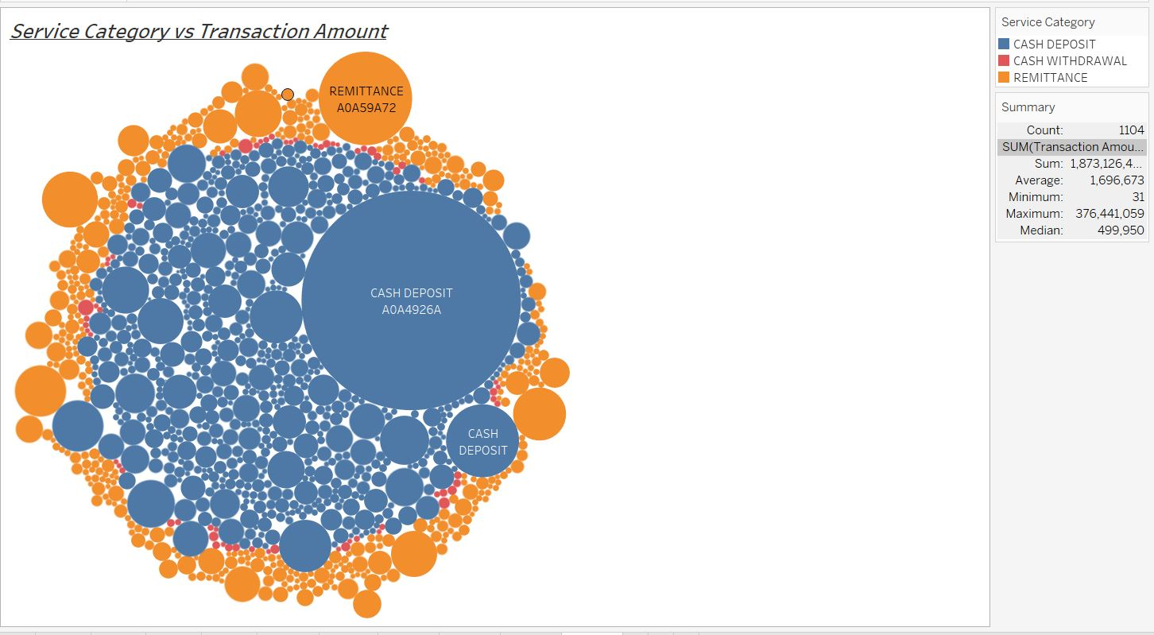

Slide 18
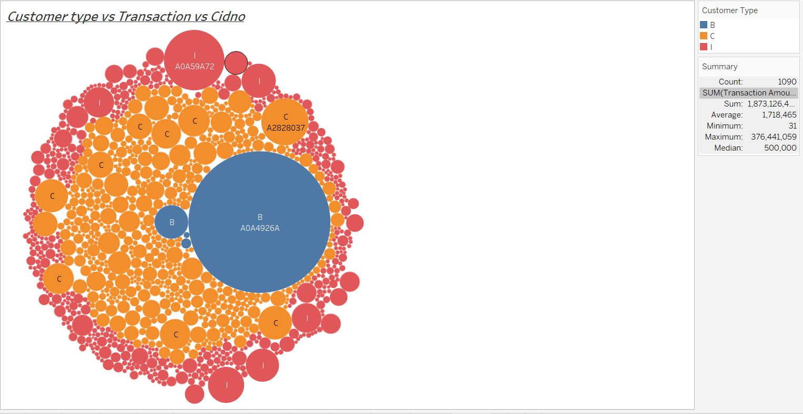

Slide 19
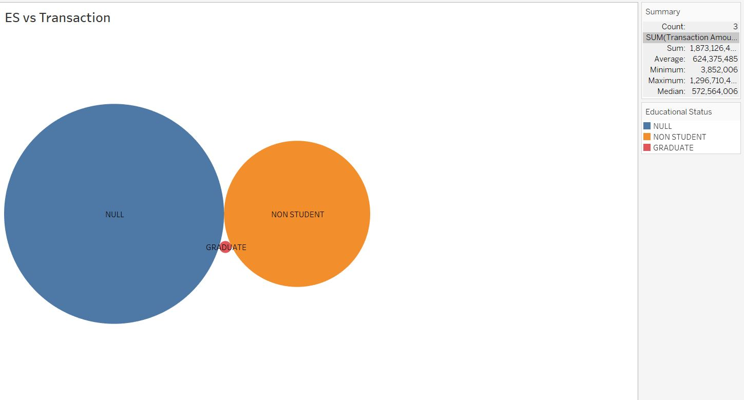

Slide 20
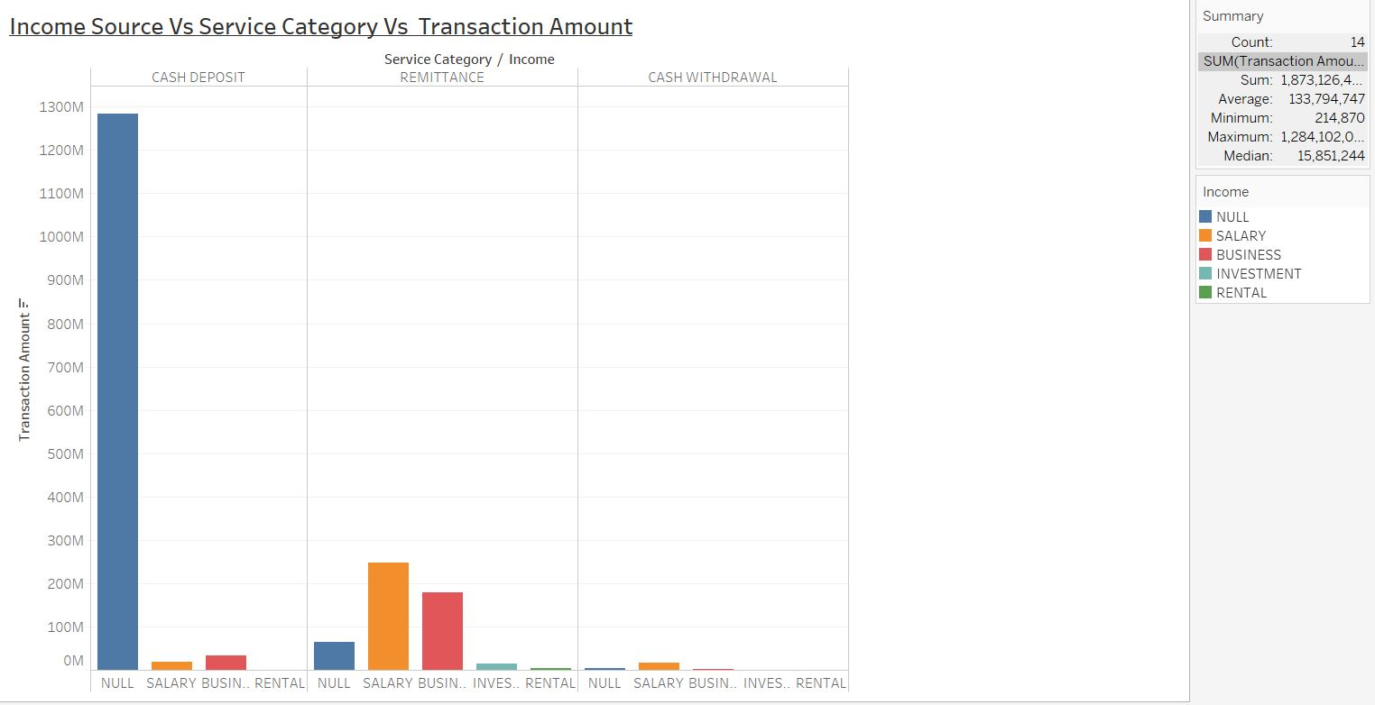

Slide 21
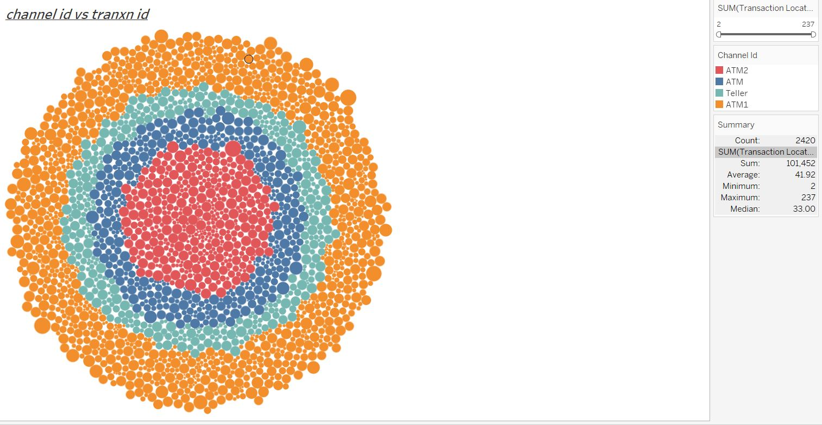

Slide 22
Major Findings
So in Exploratory Analysis we can see strong skewness in the data, with outliers catching the attention.
Also out of seventeen variables variables like gender, marital status, dob ,Age,income,minor, more than 50 % variables are of NULL values so no point in feeding these into models.
Also product type, financial products for all customers is same so no point in getting information for categorising
Transaction date, transaction time is entirely done in one month i.e on april 1stto 31st so itis not that much helpful in building the model.

Slide 23
Findings
So the remaining variables like channel id, transaction amount, customer type, service category, dependents, transaction location are the only best possible features that can be used in building the model
But the data is highly skewed and outliers are present. But we cannot remove outliers as they provide very useful information in this context

Slide 24
Feature Engineering
Except transaction amount, dependents, transaction location remaining varibles are categorical in nature
We are transforming transaction amount variable to log10 based values for reducing skewness and into scale ,also transaction location transformed to log values.
Converting categorical variables like service category, customer type, channel id to numeric in nature.
Data scaling is done for normalization through scale function

Slide 25
Algorithm usage for model building
Using Clustering technique ,in this context on the very assumption that to build model which is robust to outliers and noise here we are using Density-Based Spatial Clustering and Application with Noise (DBSCAN)
Why DBSCAN ?
Since this is advanced and robust model Partitioning methods ,unlike (K-means, PAM clustering) and hierarchical clustering which are suitable for finding spherical-shaped clusters or convex clusters. In other words, they work well only for compact and well separated clusters. Moreover, they are also severely affected by the presence of noise and outliers in the data. k means and hierarchy models which are highly sensitive to outliers and skewness data
Where as DBSCAN can be used to identify clusters of any shape in a data set containing noise and outliers which perfectly suits for the data we are currently dealing with.

Slide 26
About DBSCAN
The goal is to identify dense regions, which can be measured by the number of objects close to a given point.
Two important parameters are required for DBSCAN: epsilon (“eps”) and minimum points (“MinPts”). The parameter eps defines the radius of neighborhood around a point x. It’s called the ϵϵ-neighborhood of x. The parameter MinPts is the minimum number of neighbors within “eps” radius.
Mininum points can be calculated from no.of dimensions plus one,here in this context 6+1=7
Epsilon is critical value which is calculated from knee curve

Slide 27
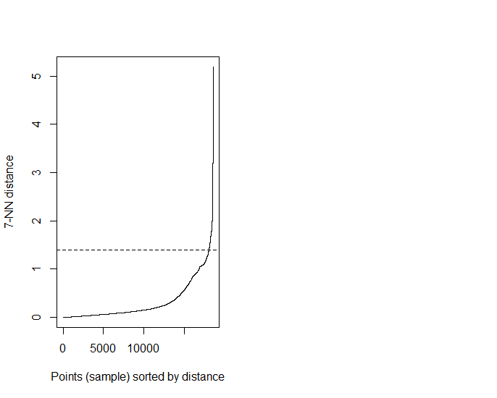
Knee curve, a kNNHistplot for identifying epsilon value
dbscan::kNNdistplot(Finalcut,k = 7 )
abline(h = 1.4, lty = 2)
So epsilon value is 1.4.
So at epsilon vale 1.4 we can find that
A knee corresponds to a threshold where a sharp
change occurs along the k-distance curve.
Libraries used for the DBSCAN
Model are :
DBSCAN package
Fpc package
factoextra etc
cluststats

Slide 28
Cluster stats of DBSCAN model
Cluster stats Report
dbscan Pts=2653 MinPts=7 eps=1.4
clusters : 0th 1st 2nd 3rd 4th
border : 59 45 0 3 4
seed : 0 637 1695 24 186
total :59 682 1695 27 190
So total four clusters with “0 “ column is outliers i.e 59 outliers were present
1st cluster containing 682 observations
2nd cluster contains 1695 observations
3rd cluster contains 27 observations
4th cluster contains 190 observations

Slide 29
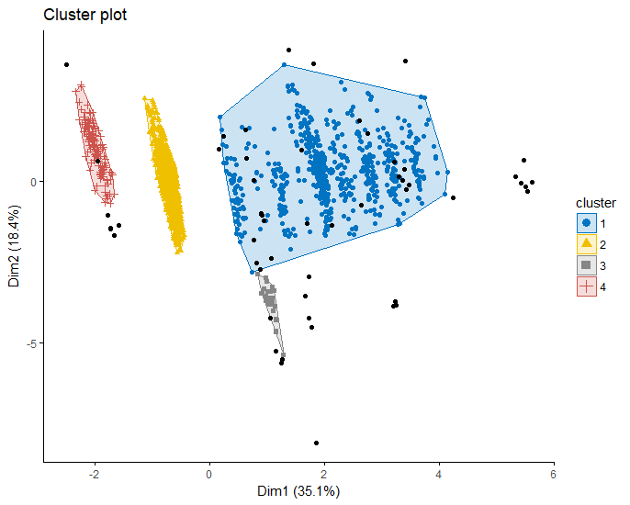
Clusters formation
Finally four clusters are formed
The black dots are outliers.
We can see inspite of outliers
Presence, clearcut
segmentations can be viewed.
These are density based
sizes are formed.

Slide 30
Recommendations
So five clusters along with outliers, the bank customers were segmented into.
The smallest cluster comprises of 27 customers where as largest cluster comprises of 1695 customer base
Now bank management can build different marketing strategies by pitch different /new type of financial products /services depending upon the target segment with a strong unique selling proposition where high conversion rates can be seen since we are targeting the product to the right customer segment.

Slide 31
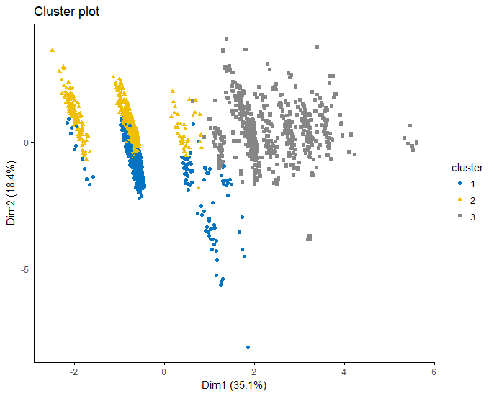
conclusion
Finally DBSCAN model works better handling outliers with clearcut segmetation,unlike kmeans .I will show the clusters in kmeans and DBSCAN.so below you can see the variation between kmeans and DSCAN, where in DBSCAN clearcut segmentation can been seen inspite of outliers presence when fed both the models with same data.
K-Means Clustering DBSCAN

